Slide 1
Project
Explanation
Problem : Predicting hospitals readmission for patients with diabetes
Reported by
S.Mahammad Ali
C.Niveda Reddy
L.Manjula
P.Reddy Rani
Harish Kumar Reddy

Slide 2

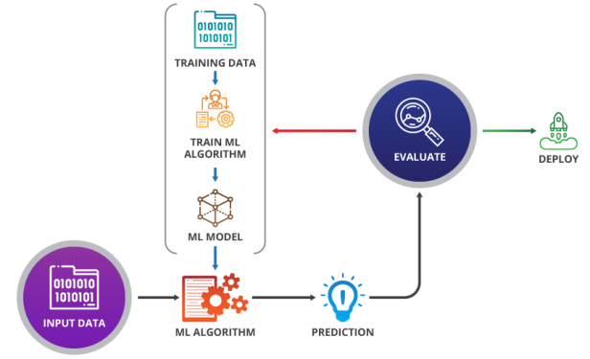

+
Machine learning

Slide 3
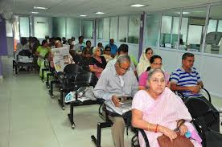
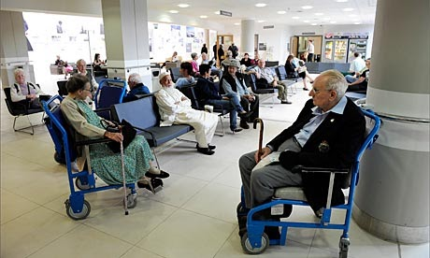
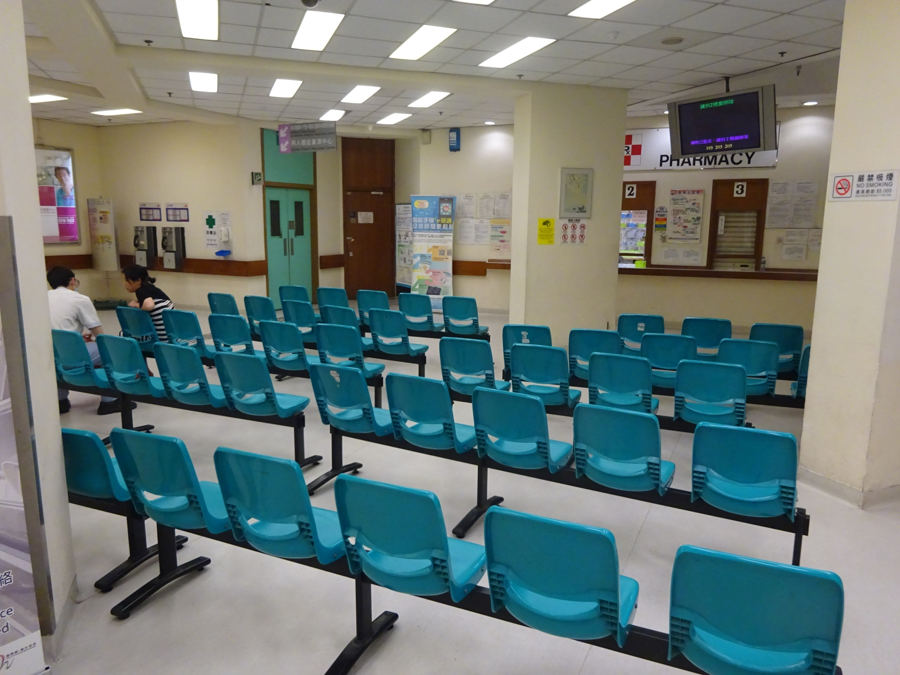
Problems of patients in waiting hall
Waiting hall is vacated with our model

Slide 4
Model selection
Linear Regression
KNN ( K Nearest neighbour)
SVM (Support Vector Machine)
Decision tree claasifier
Random forest classifier

Slide 5
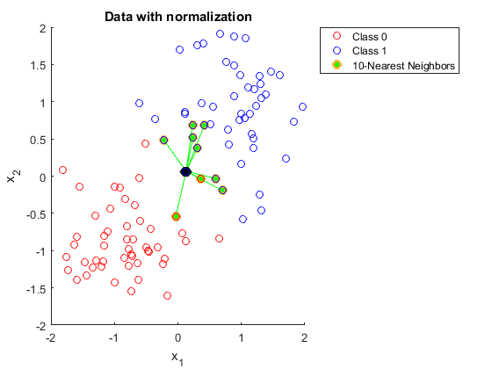
KNN model explanation

Slide 6
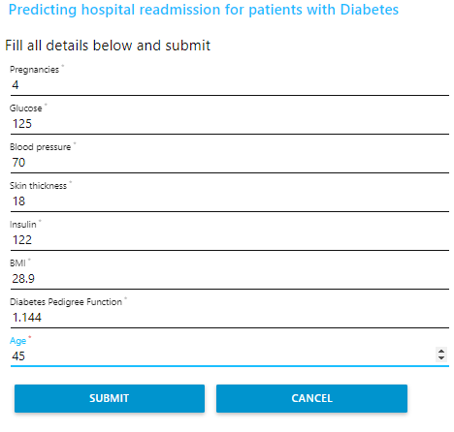
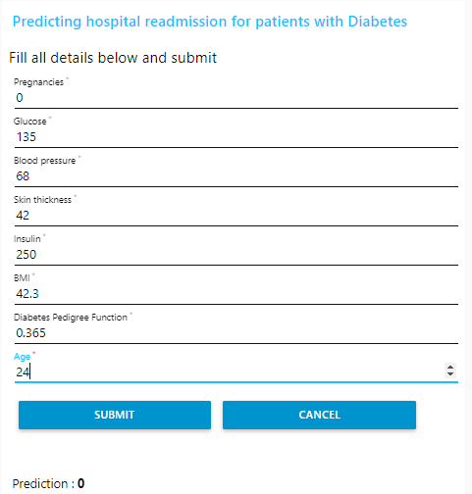

Attributes
Pregnancies
Glucose
Blood Pressure
Skin Thickness
Insulin
BMI
Diabetes Pedigree Function
Age
Problems
Lack of Hospital services
Reimbursment of Hospitality

Slide 7
Heart full tahnks to sir akshay kothuri hemant nikhil To share their valuable knowledge with us
Thank you

